Slide 1


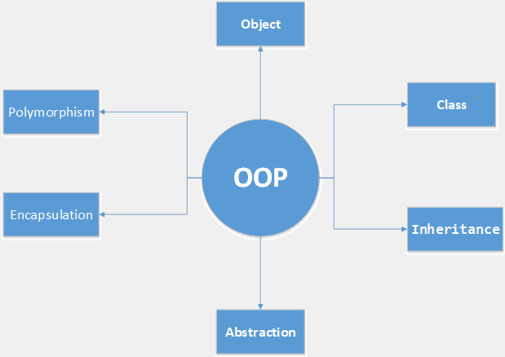

OOP Course - Virtual Trip
First View to OOP course
Java OOP
SoftUni Team
Ventsislav Ivanov
Software University
http://softuni.bg

Slide 2


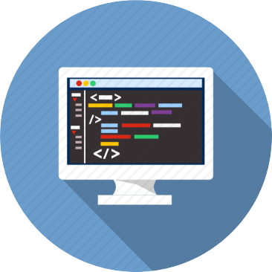
Table of Contents
What are Objects?
What is OOP?
Cohesion and Coupling
Exam Overview

Slide 3
Have a Question?
sli.do #Java-OOP

Slide 4

What are Objects?
Real-Life Objects in Programming

Slide 5

What are Objects?
class Person {
Double height;
String skinColor;
List<Clothes> clothes;
}
class Person {
Integer age;
String hairColor;
List<Clothes> clothes;
}

Slide 6

Initialization of Object
Person ventsi = new Person()
Person ventsi =
new Person(1.85, "White", clotes)
Person ventsi =
new Person(27, "Brown", clotes)

Slide 7
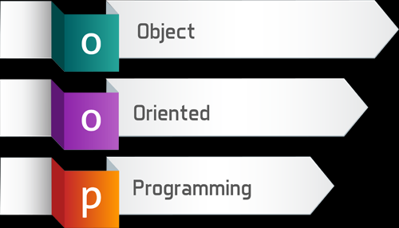
What is OOP?
Object Oriented Programming

Slide 8
What is OOP?
Object-Oriented Programming
Property
field or attribute
OBJECT
Methods
DoSomething()
Object-oriented programming (OOP) is a programming paradigm based on the concept of "objects", which may contain data, in the form of fields, often known as properties; and code, in the form of procedures, often known as methods.

Slide 9
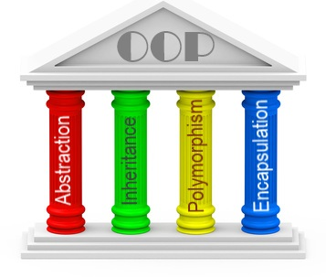
Four Pillars of OOP

Slide 10
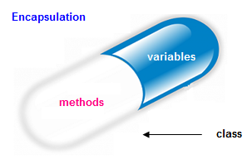
Encapsulation
Variables of a class will be hidden from other classes
Accessed only through the methods of their current class
public class Person {
Integer age;
Integer getAge() {
return this.age;
}
void setAge(int age) {
this.age = age;
}
}
private
public
public
private

Slide 11


Inheritance
Process where one class acquires the properties of another
Information is made manageable in a hierarchical order
public class Mammal {
public Point move(Point x, Point y)
}
public class Person extends Mammal {
public void speak (String words)
}
public class Cat extends Mammal {
public void myau()
}

Slide 12
Polymorphism
Ability of an object to take on many forms
Parent class reference is used to refer to a child class object
public interface Animal {}
public class Mammal {}
public class Person extends Mammal implements Animal {}
Person IS-A Person
Person IS-A Animal
Person IS-A Mammal
Person IS-A Object

Slide 13
Abstraction
Focus on necessary context for user
public abstract class Mammal {
public Point move(Point x, Point y)
TODO: Add moving logic
}
public class Person extends Mammal {
}
Mammal cat = new Mammal(); // can't be instantiated
Mammal ventsi = new Person();
ventsi.move();

Slide 14
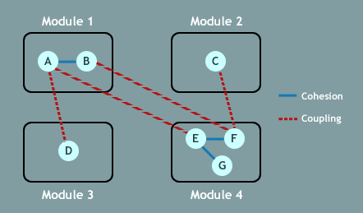


Cohesion and Coupling
key
value
Strong Cohesion and Loose Coupling

Slide 15
Cohesion
Measures the strength of relationship between pieces of functionality within a given module / class
Strong Cohesion
Low Cohesion
Staff
Double salary;
DateTime payday;
setSalary(newSalary)
getSalary()
paySalary()
Staff
checkMail();
sendMail();
emailValidate();
printMail();
saveMailInDB();

Slide 16
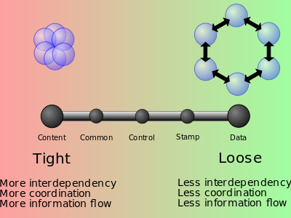
Coupling
How related are two modules / classes
Subclass Coupling
The child is connected to its parent, but the parent is not connected to the child.
Temporal coupling
When two actions are bundled together into one module just because they happen to occur at the same time.

Slide 17
Exam Overview
Live Demo on Next Exam

Slide 18
The Map Class in JS
Extract input data for each family
Build a OOP structure of city with many houses and people
Build a proper structure for houses
Organize all items in houses
Make economy of all houses
Send salary and pay bills for every houses
Build logic how families go away from city

Slide 19










Objects and Associative Arrays
https://softuni.bg/courses/javascript-fundamentals

Slide 20
License
This course (slides, examples, demos, videos, homework, etc.) is licensed under the "Creative Commons Attribution-NonCommercial-ShareAlike 4.0 International" license

Slide 21






Free Trainings @ Software University
Software University Foundation – softuni.org
Software University – High-Quality Education, Profession and Job for Software Developers
softuni.bg
Software University @ Facebook
facebook.com/SoftwareUniversity
Software University @ YouTube
youtube.com/SoftwareUniversity
Software University Forums – forum.softuni.bg

